Slide 1
SOSA Enabled Automotive Technologies Disrupt the Battlefield
Bill Pilaud, Chief Solutions Architect

Slide 2
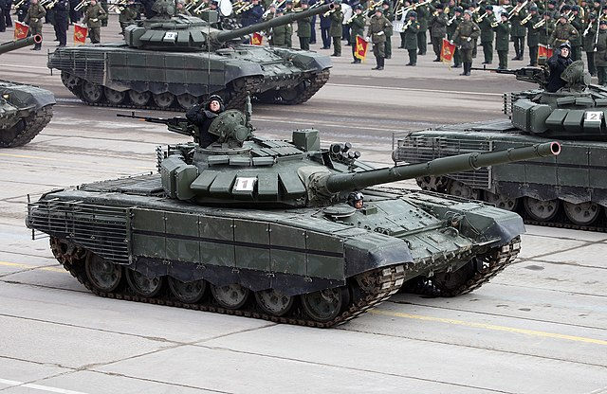
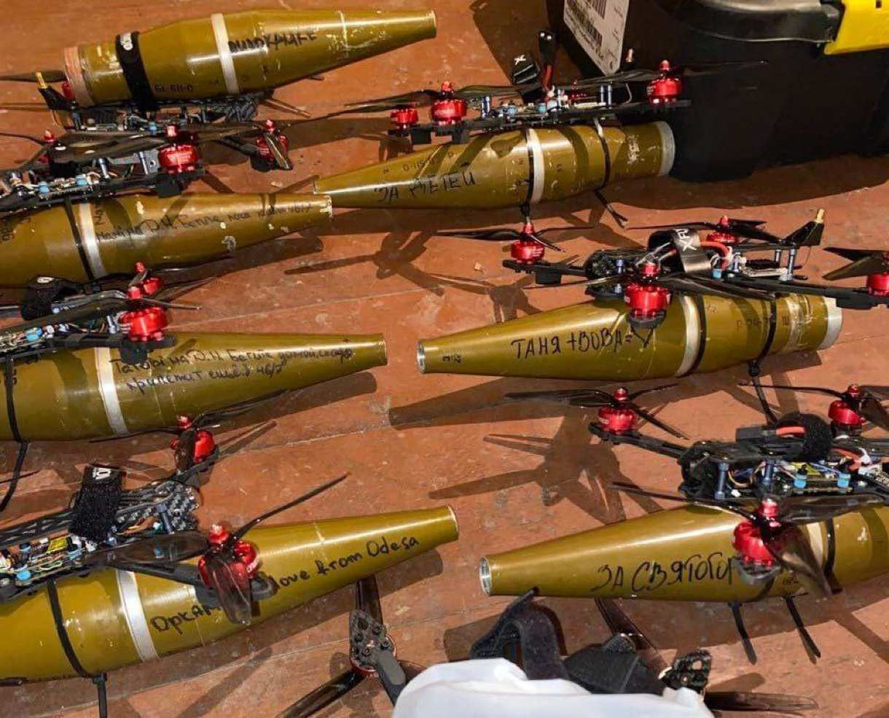
Quit Fighting Yesterday’s WAR!

Slide 3
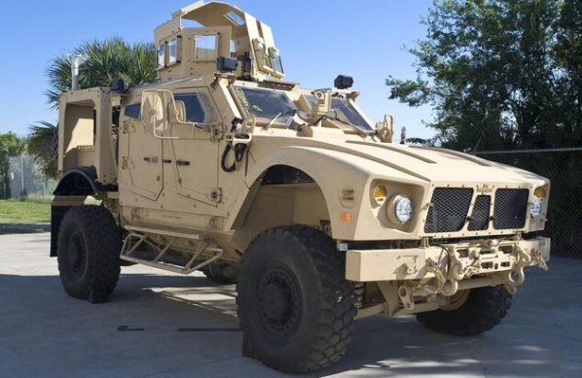
C5ISR Issues
Too many sub-systems and an ever-changing threat environment.
SIG/INT
COMS
360SA
APNT
Challenges
Increasing Operational tempo, low decision latency
Contested Spectrum and bandwidth scarcity
PNT degradation and timing
Cyber EW deception
Survivability, attrition, and graceful degradation
Environmental extremes SWAP-T Constraints
  Power budgets and energy discipline
Maintenance and serviceability at the edge
  Interoperability
Human machine teaming and cognitive overload
Data Stewardship and sovereignty
Technical change and acceleration of new threats

Slide 4
The Disruption
ARTIFICIAL INTELLIGENCE
Challenges
Increasing Operational tempo, low decision latency
Contested Spectrum and bandwidth scarcity
PNT degradation and timing
Cyber EW deception
Survivability, attrition, and graceful degradation
Environmental extremes SWAP-T Constraints
  Power budgets and energy discipline
Maintenance and serviceability at the edge
  Interoperability
Human machine teaming and cognitive overload
Data Stewardship and sovereignty
Technical change and acceleration of new threats
360SA
COMS
APNT
SIG/INT

Slide 5
Sensor Chain – C5ISR
Sense, Identify, and Act
HMI
Store
Learn
Decide
DSP
Digitize
Sensor
T/R
30 ms
GB/s
Millions Tokens/s
1-100TFLOP/s
Gsamples/s
Analog (0Hz-30GHz)
APNT
COMS
SIG INT
360SA

Slide 6
SOSA – Sensor Open Systems Architecture
www.opengroup.org/sosa
A collaboration of U.S. armed services, tier-one defense primes, academia, and open systems providers.
Mandated by the Secretaries of the Navy, Army, and Air Force as a requirement for future weapon systems
Leverages open standards like FACE, MORA, Victory, and VITA (VPX/VNX) form factors
SOSA defined VITA Plug-In Cards (PICs) are available to meet operational requirements for any C5ISR
Optimized (Standards-based) Enclosures enable PICs to be deployed on any Platform
SOSA– THE preferred strategy for deploying Modular Open Systems Approach (MOSA)

Slide 7

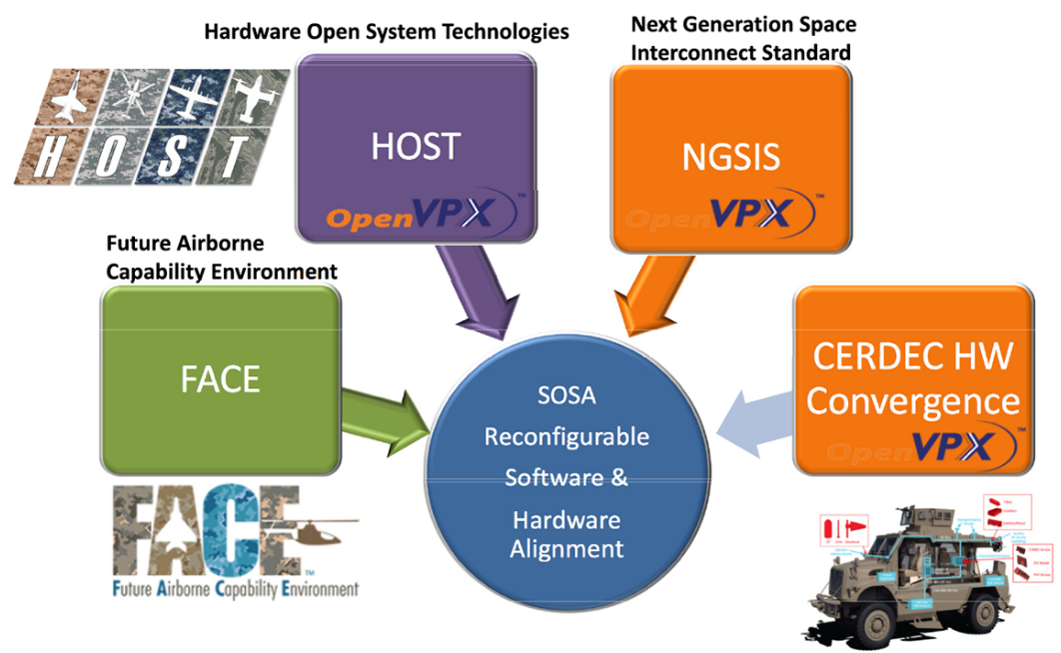
SOSA
Subset of VITA hardware and a large infrastructure of SOFTWARE
www.VITA.org
SOSA
VPX/VNX
SOSA-aligned
profiles

Slide 8
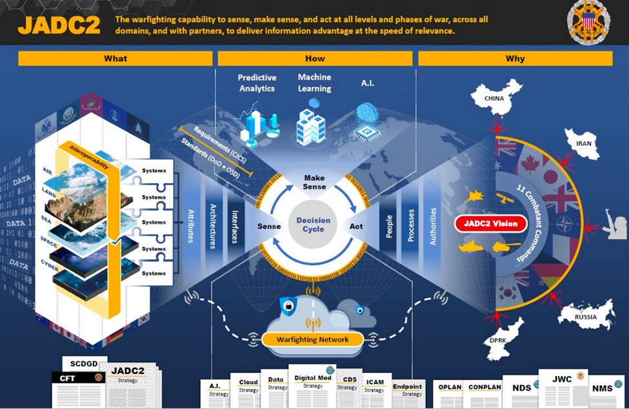
HPEC Axioms
Maximize FLOPS
Leverage Open Standards (HPC)
Constrained by SWAP
Operate in Harsh Environments
Secure
Needs Multi-processor
High Speed low latency fabric
System performance depends on minimizing latency
FPGAs integral with sensor interfaces
Sensors and HPEC system are co-located – system is not dependent on external network connection

Slide 9
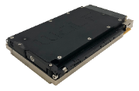
Sensor Chain Becomes PICs
(Plug-in Cards)
HMI
Store
Learn
Decide
DSP
Digitize
Sensor
T/R
SBC
SBC/SSD
SBC/GPGPGU/FPGA
SBC/GPGPGU/FPGA
SBC/XMC/FPGA

Slide 10
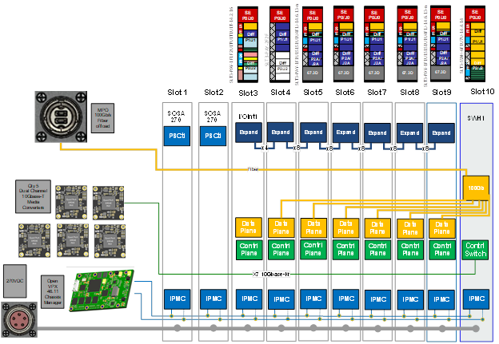
HPEC Architecture
HMI
Storage
DSP
Switch

Slide 11
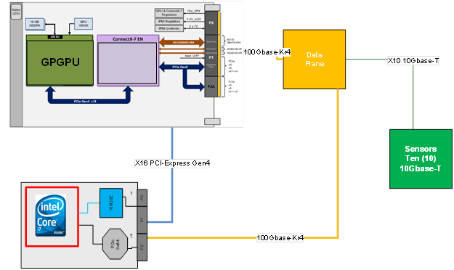
Traditional SBC/GPGPU DSP Cluster
41 TFLOPS (Ada) -> 160 TFLOPS (Blackwell)

Slide 12
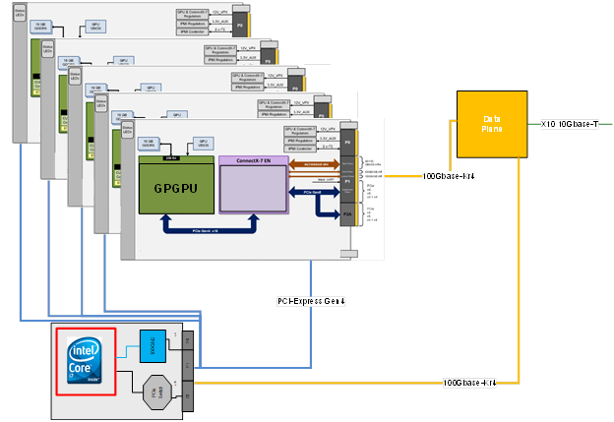
Maximized GPGPU Cluster
900 TFLOPS

Slide 13
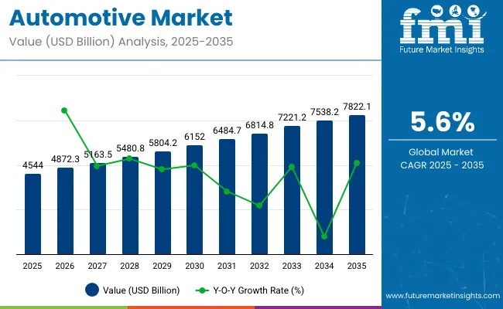
Automotive Market Disruption
Big Market $4.3 Trillion Market
Electrification at Scale
Autonomy and Advanced Drive Assistance
Software-defined vehicles open new revenue
Supply Chains, Tariffs, and Localization
AI integration everywhere (engineering, manufacturing, cybersecurity, and product)

Slide 14
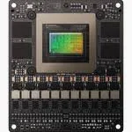
NVIDIA Jetson THOR
14 Core Arm processor with Blackwell
        2070 TFLOPS (2 Petaflop)
  40-130W operation
Built-in Security and Safety
100Gigabit integrated sensor with Holoscan
Software infrastructure from simulation to rapid inference deployment
Holoscan – FPGA through fabric optimization to minimize sensor to processing latency with ready-made sensors (camera, IR, RADAR, communications etc).

Slide 15
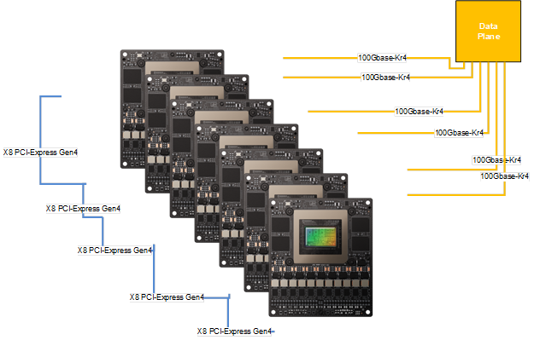
HPEC System
12 Petaflops -> 1050 Tokens/second
HOLOSCAN
FPGA
(GPGPU direct)

Slide 16
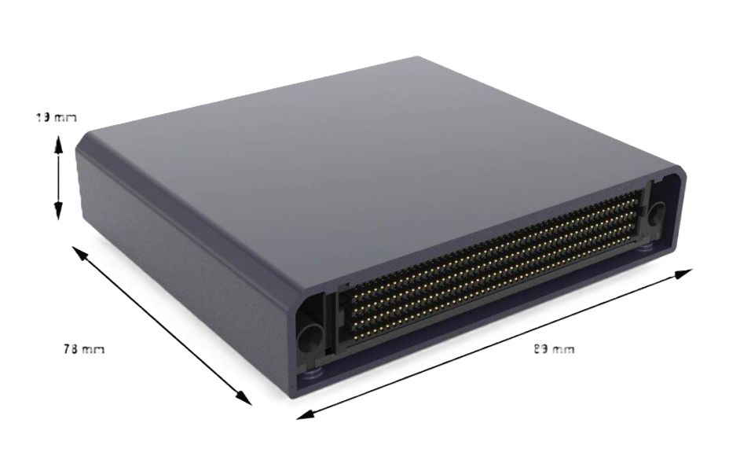
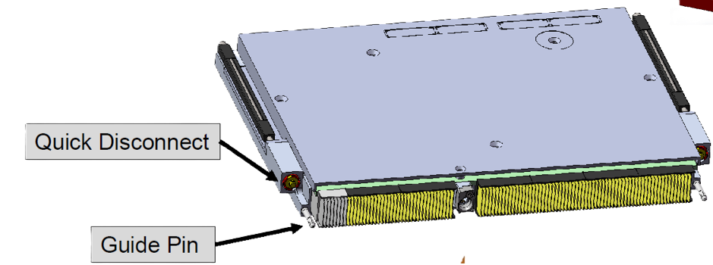
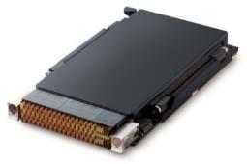
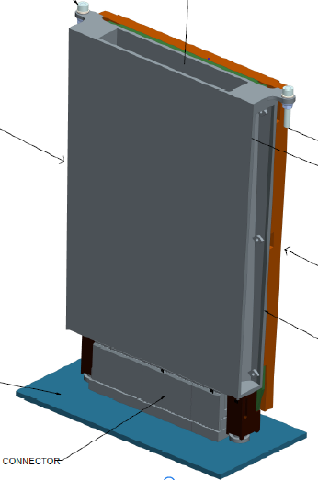
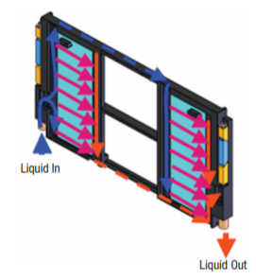
SOSA
VPX/VNX – SWAP optimized for all platforms
VNX < (Small Credit card) – < 60W
VPX (VITA 46/VITA 100)
  3U (Laptop, SOC, or RFSOC)
  6U (HPC FPGA/GPGPU)
Conduction Cooled (VITA 48.2) < 100W
Air Flow Through (VITA 48.8) 100W-200W
Liquid Flow Through (VITA 48.4) > 200W
    Liquid side wall – Vita 48.2
Air in / out
Air in / out

Slide 17
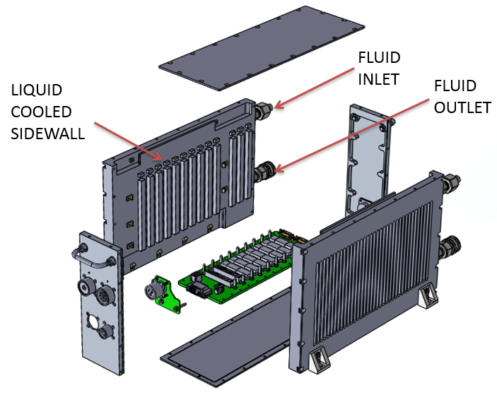
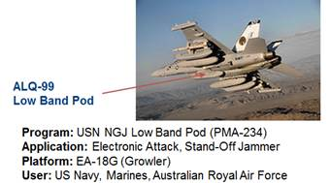
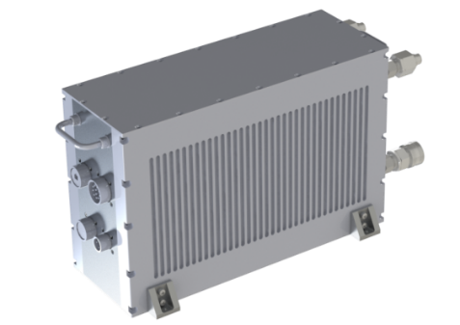
Liquid Cooled Chassis
Examples using VITA 48.2 Modules
LCR Solution Example…
For higher wattage applications
Liquid-cooled sidewall cold plates
Conduction-cooled VITA 48.2 VPX modules
Avionics VPX Chassis used on EA-18G (Growler) – NGJ Pod

Slide 18
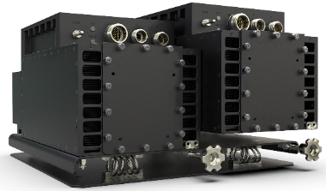
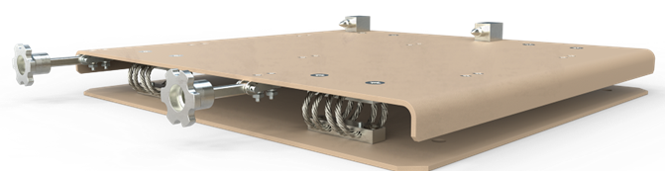
Chassis Level Standardization - SAVE
Full SAVE footprint
Standardized A-Kit / Vehicle Envelope (SAVE)
SAVE applies to any modular system electrically and/or digitally integrated into an Army platform
Describes the size and shape of a standard mounting location, or "envelope," and set of physical and electrical interfaces for C5ISR systems in Army platforms
    15.9” wide x 16.1” deep x 9.3” tall
Intended to be compatible with VICTORY, CMOSS, SOSA and other current standards in support of MOSA architectures
Half SAVE – split for multi-system or redundancy support
SINCGAR VRC91 mounting per the SAVE specification

Slide 19
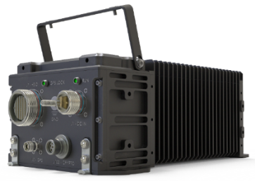
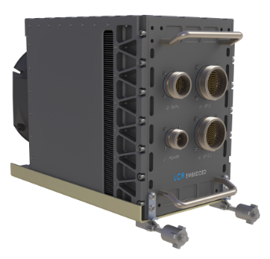
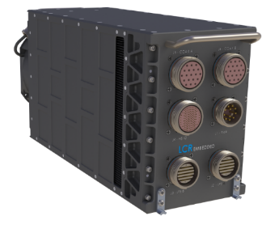
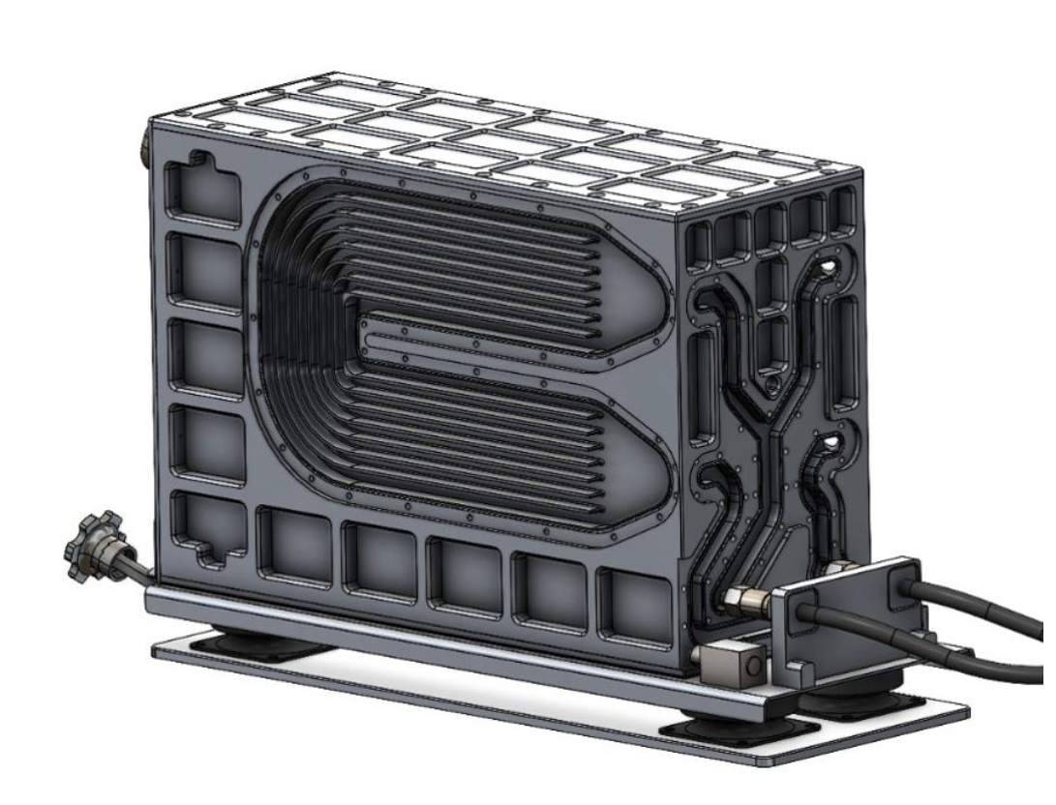
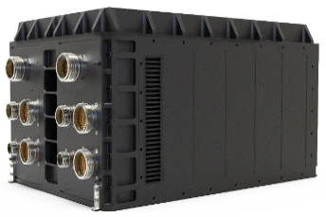
ATR – Airborne Transport Rack
Addressing a range of Army aviation and ground applications
Extensible base design strategies enable quick turn solutions across slot counts`
Horizontal card insertion up to 4 SOSA PICS
Vertical card insertion up to 6 SOSA PICS
Vertical card insertion up to 10 SOSA PICS
Liquid side wall option
Vertical card insertion up to 20 SOSA PICS

Slide 20
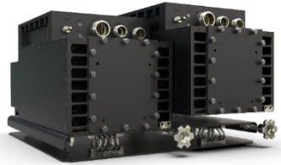
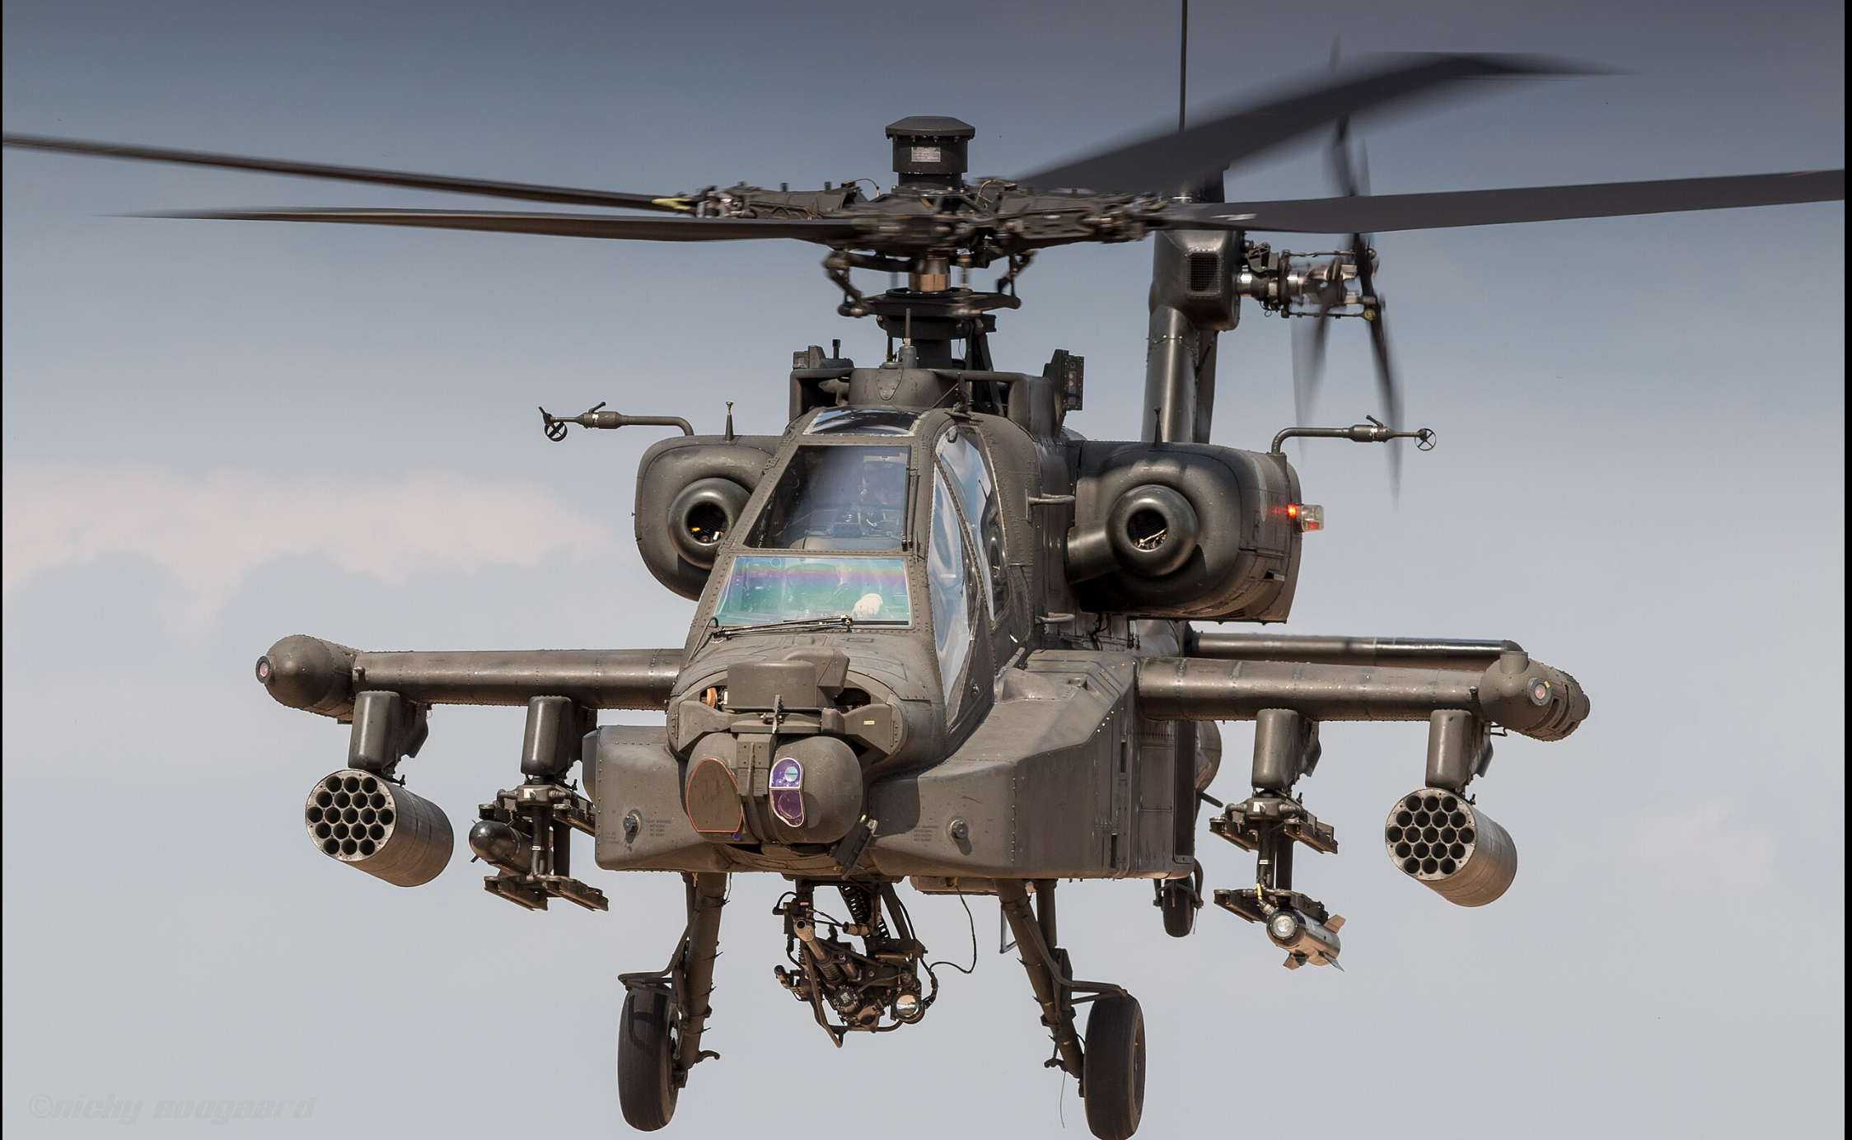

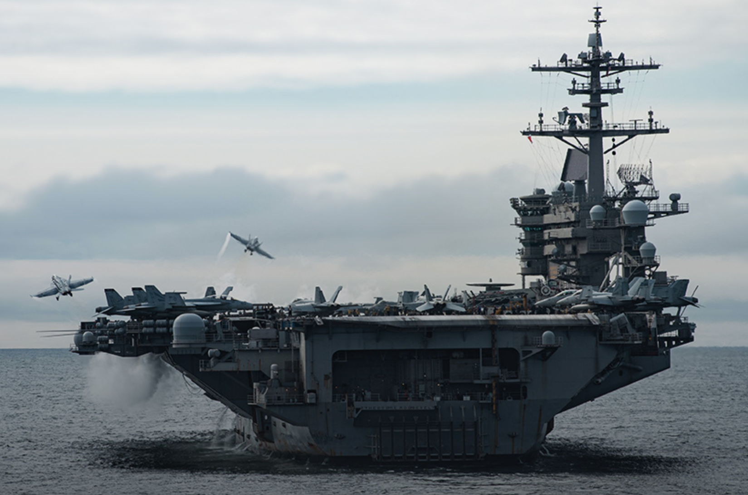
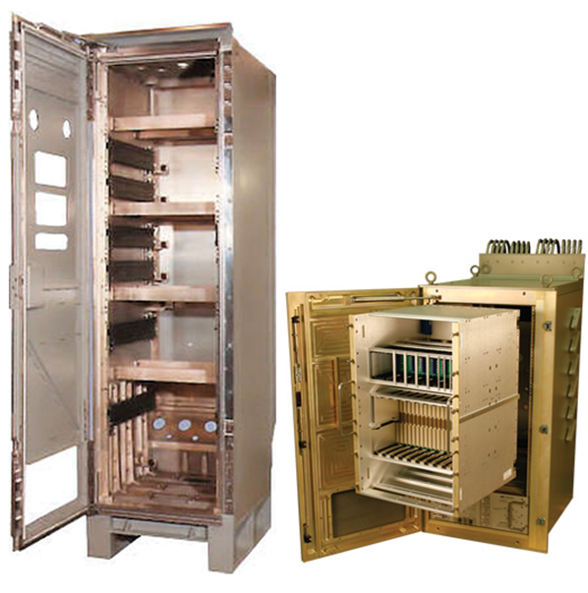
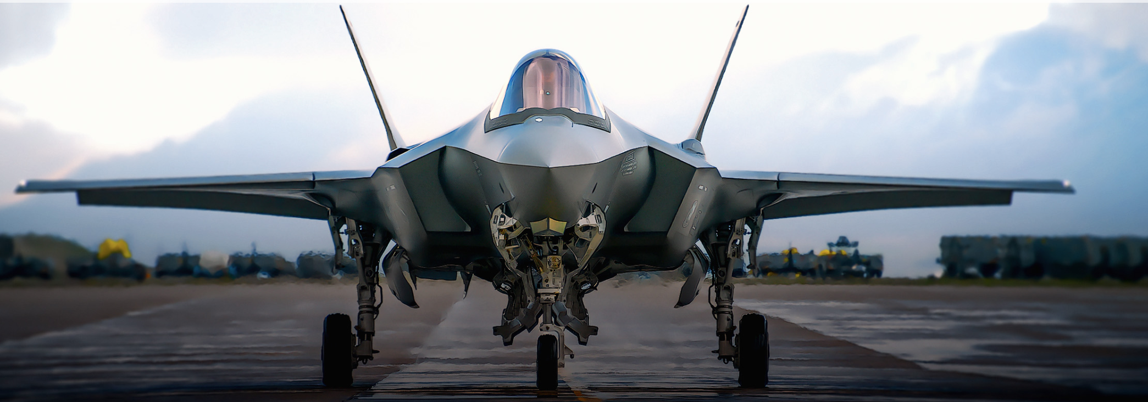
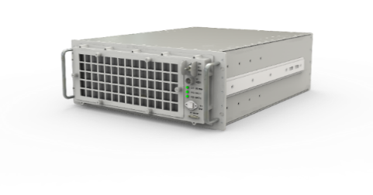
SOSA/VPX – Enclosure Agnostic
PICs enabled by Enclosure Optimized to Platform
SAVE/Ground Mobile
SOSA/VPX systems are applicable to all current and emerging chassis types in military embedded systems.
Airborne Transport Rack (ATR)
19” Rackmount/Ships subs

Slide 21
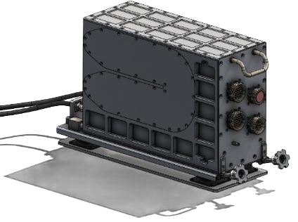
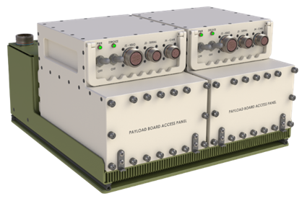
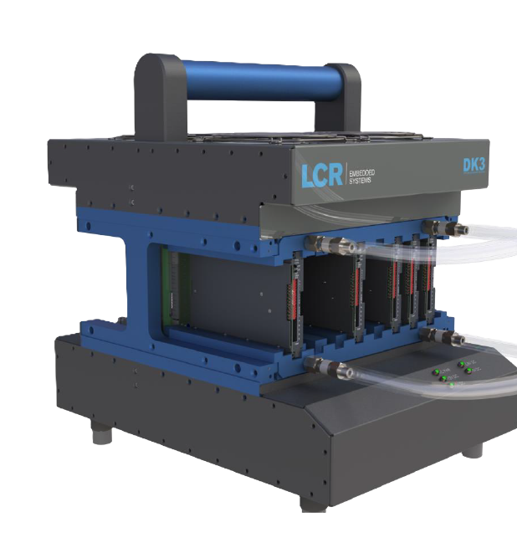
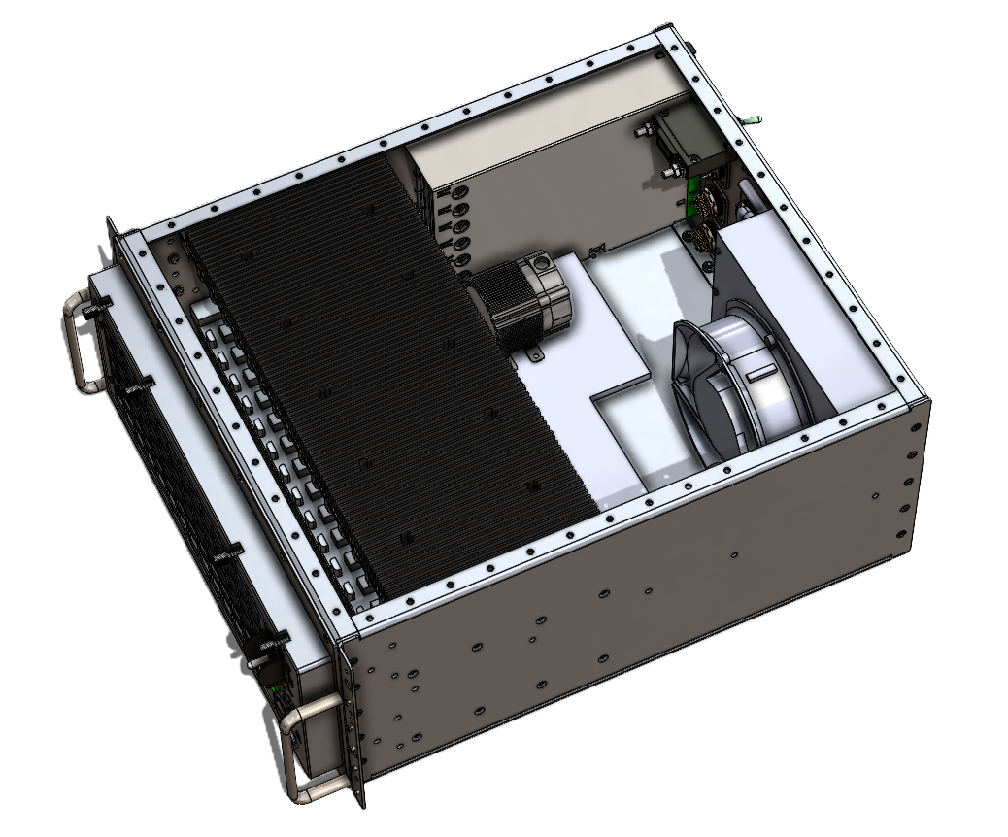
Liquid-Cooled
Systems are available for all three Military platforms

Slide 22
Added HPEC Axioms
Must operate autonomously with reduced network or network-denied environments
Must have an AI part of the system
Smart Fabrics are necessary to scale and leverage technical change (RDMA Ethernet)
HPEC systems must be liquid cooled – Next-generation AI inference engines exceed air cooling, and heat density exceeds air cooling options.

Slide 23
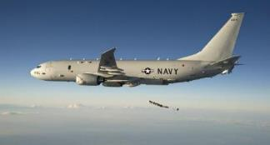
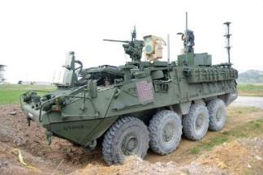
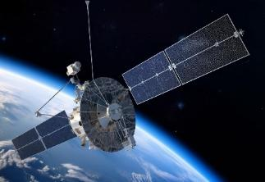
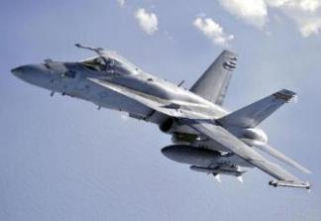
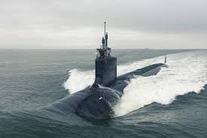
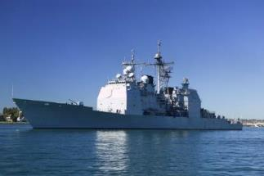
THANK YOU!
For more information, see white paper.
www.lcrembeddedsystems.com/mosa-strategy-support-warfighters

